Slide 1
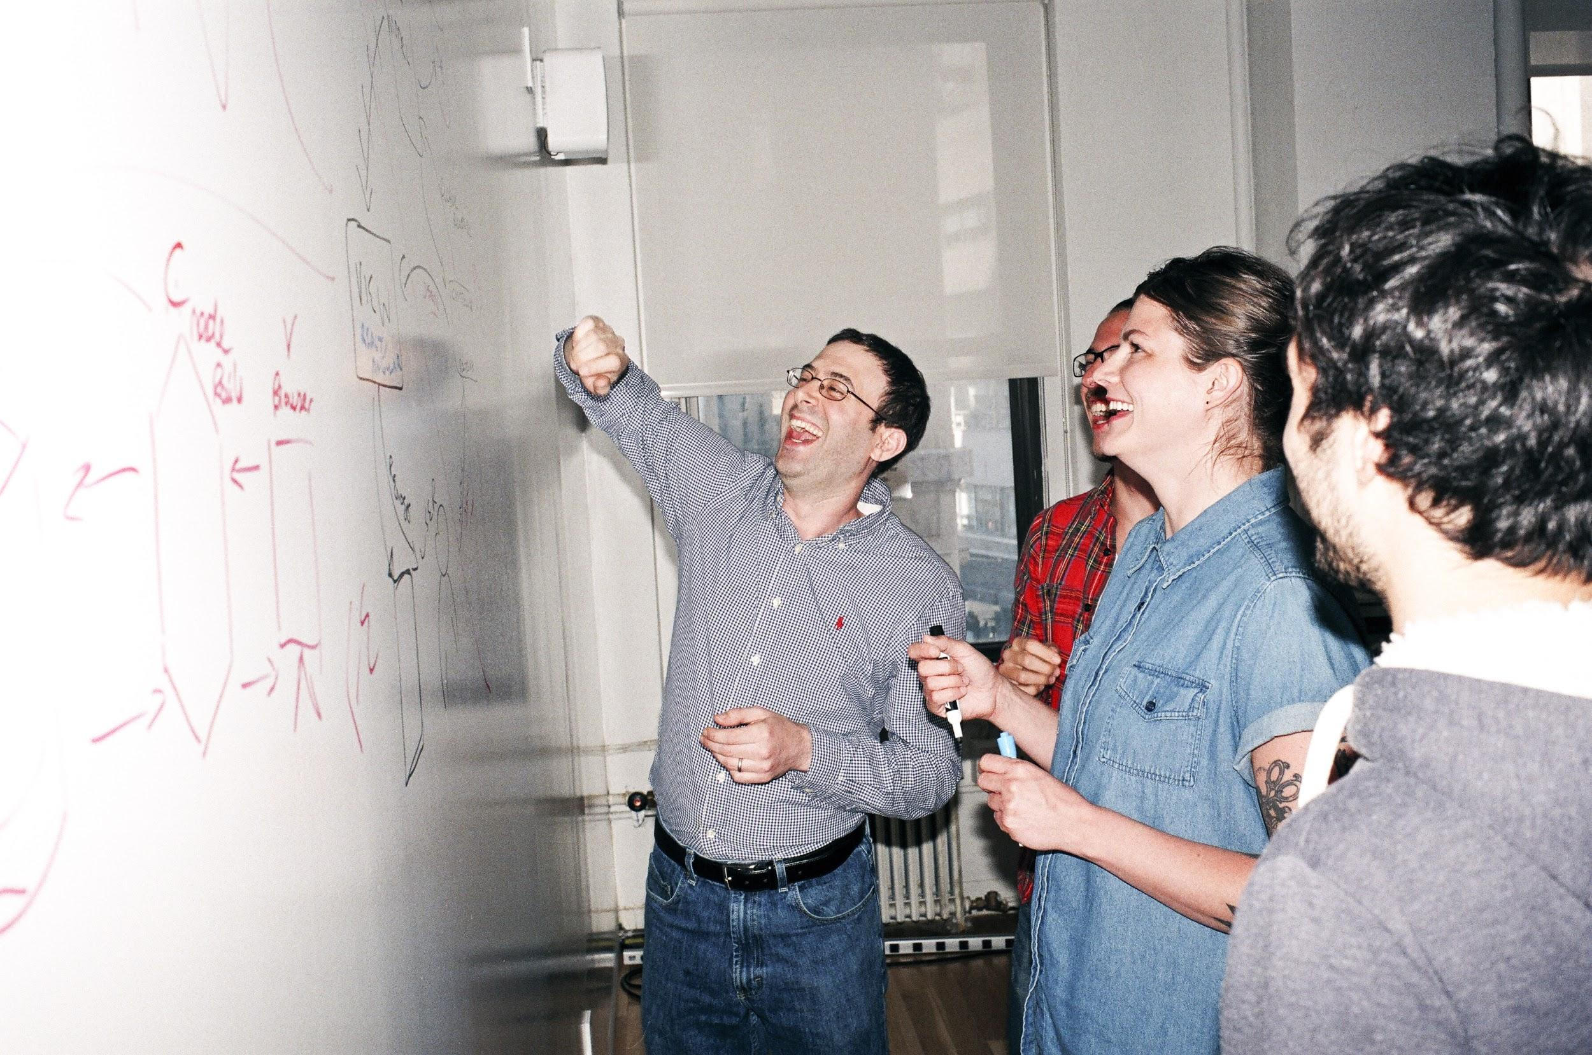

Welcome to General Assembly
WiFi GA Guest
Password yellowpencil
Notes:
[Leave this slide visible until presentation starts]

Slide 2
DATA SCIENCE
SYD DAT 10
Week 2 - Linear Regression

Slide 3
AGENDA
Key: Interactive Paul Presenting
Course Plan revisited
Review – Git & GitHub setup
Recap last time & Homework Presentations
Visualisation Lab continued (Class 3)
Supervised Vs Unsupervised learning
What is Linear Regression?
How do Run a Linear Regression Model?
Multiple Linear Regression
Non-Linear Effects
Regression Lab
Discussion / Review / Homework

Slide 4
Course Plan

Slide 5
Git & GitHub – 1 Pager Guide!
Squash the GIT confusion from last class!
1-Pager follows through the steps clearly
Run through this once together ➔ CRYSTAL CLEAR

Slide 6
Git & GitHub – 1 Pager Guide!

Slide 7
Git & GitHub – 1 Pager Guide!

Slide 8
Git & GitHub – 1 Pager Guide!

Slide 9
Recap – last lesson
Homework Presentations ~ 2mins each

Slide 10
Tostee

Slide 11
Andrew

Slide 12
Suren

Slide 13
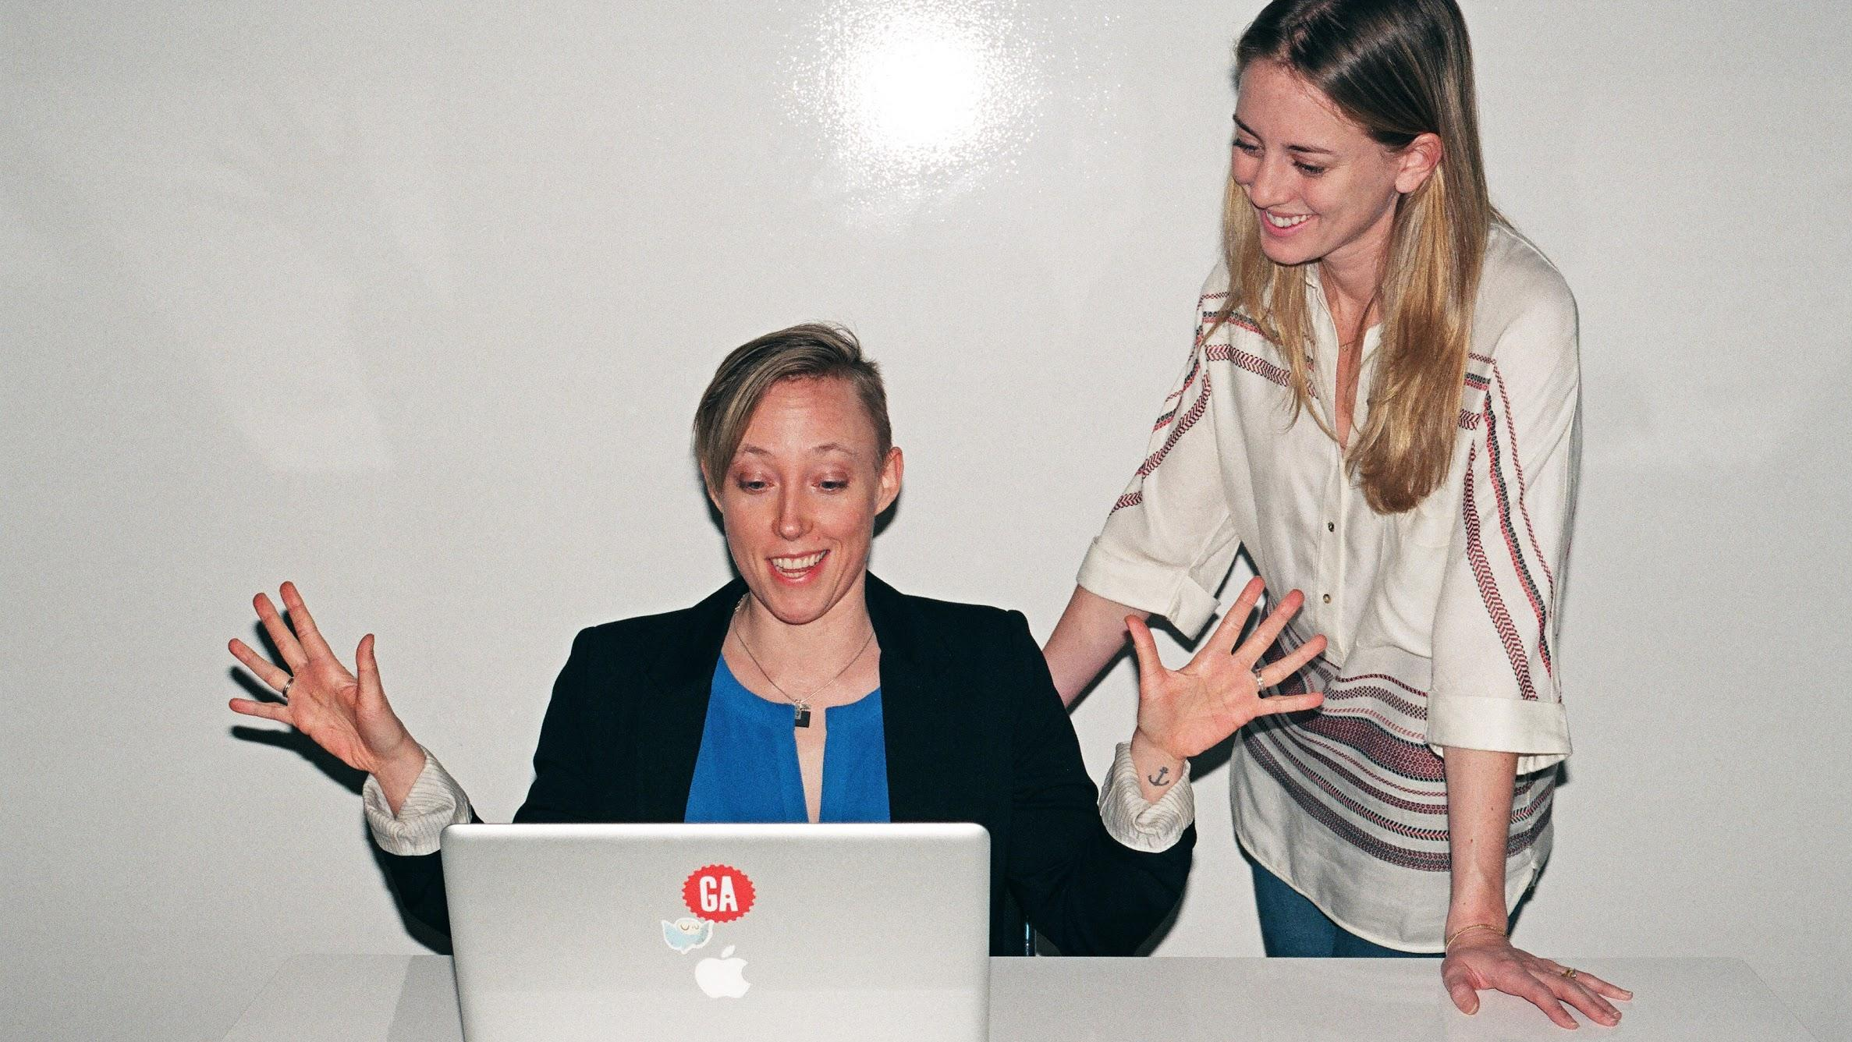
Enough talking…
Let’s do some lab work:
dat11syd/lessons/lesson-03/lab/lesson-03-lab-02_Visualisation

Slide 14
SUPERVISED & UNSUPERVISED LEARNING
DATA SCIENCE PART TIME COURSE

Slide 15


SUPERVISED LEARNING
Learning by example.

Slide 16

TARGET
What do we want to model?
Often we want to predict something.
Who will win a match
What a customer wants
The value of a stock
The time until an event
The target may also be called:
response variable
dependant variable
label

Slide 17
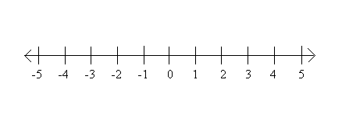
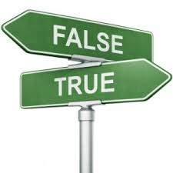
SUPERVISED LEARNING - REGRESSION & CLASSIFICATION
Regression:
If the target variable is numeric then we have a regression problem - we are trying to predict a continuous number
Classification:
If the target variable is a category (for example trying to predict a type of flower) the we have a classification problem - we are trying to classify what group that y belongs to.

Slide 18
FEATURES
The data values that provide information to help guess the target
The features may also be called:
predictor variables
independent variable

Slide 19
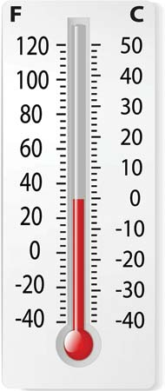
FEATURES
The data values that provide information to help guess the target
The features may also be called:
predictor variables
independent variable
Today’s Air Pressure
Today’s Temperature
Tomorrow’s Temperature
~>
Today’s Humidity
Today’s Cloud Cover

Slide 20
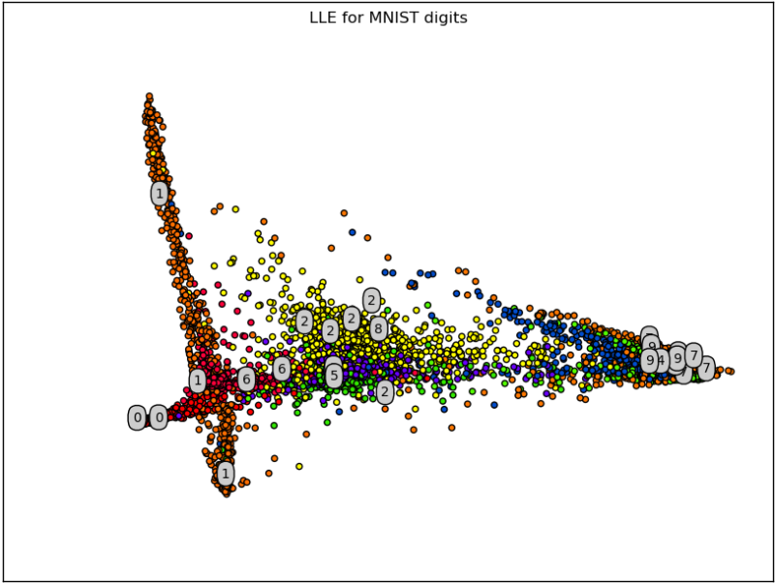
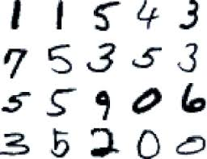
UNSUPERVISED LEARNING
Find structure in data, such as clusters.
We want to find some underlying structure or patterns in the data but in this case we don’t have any labeled data.
http://projector.tensorflow.org/

Slide 21
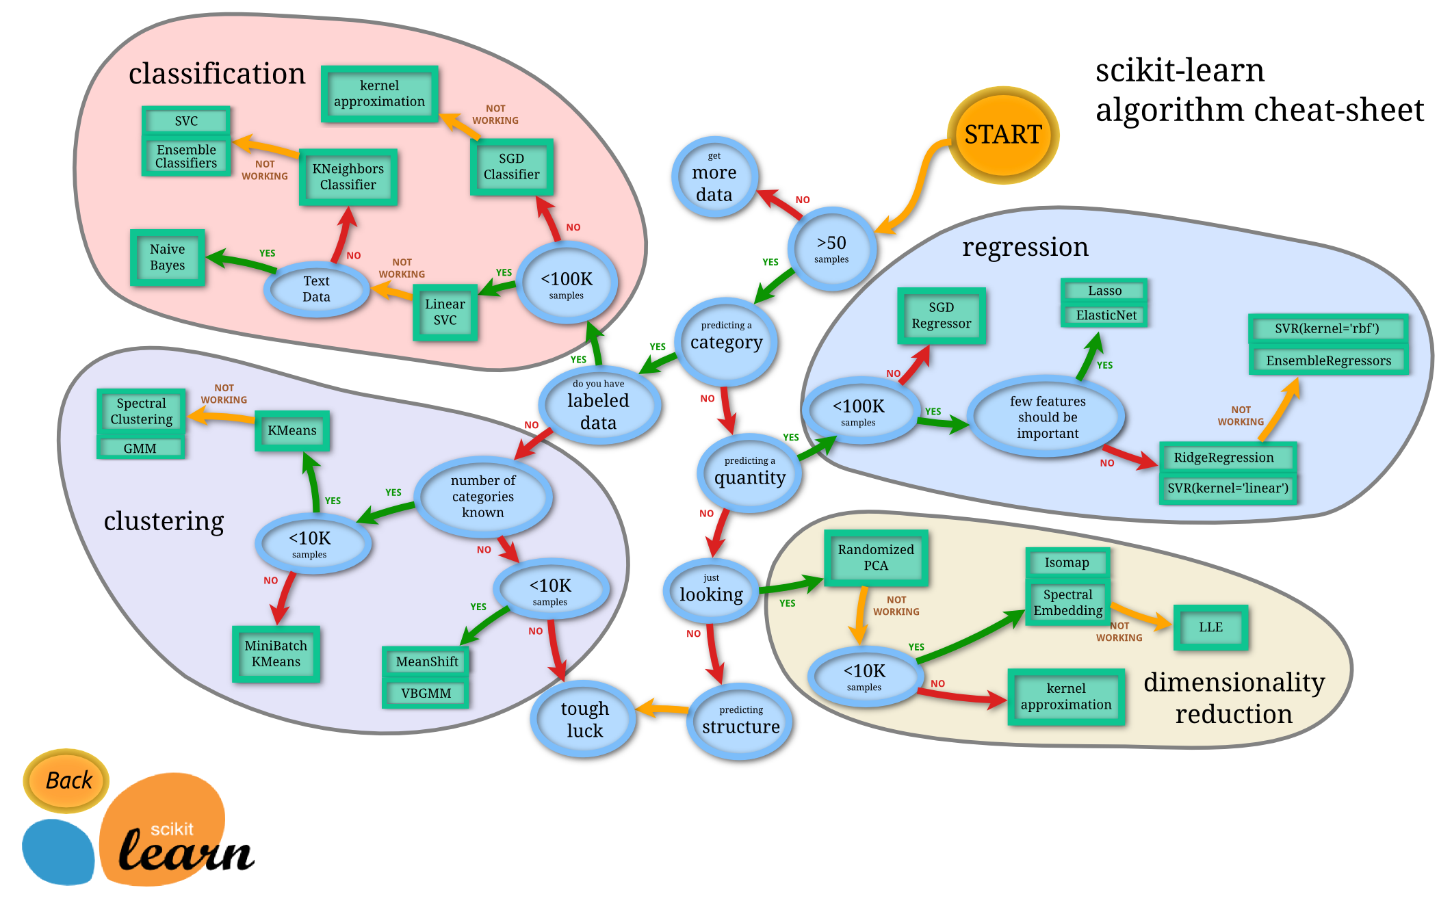

Slide 22
WHAT IS LINEAR REGRESSION?
DATA SCIENCE PART TIME COURSE

Slide 23
LINEAR REGRESSION
We want to model a linear relationship (think straight line) between our target variable y and our input variable x.
y=mx+b

Slide 24
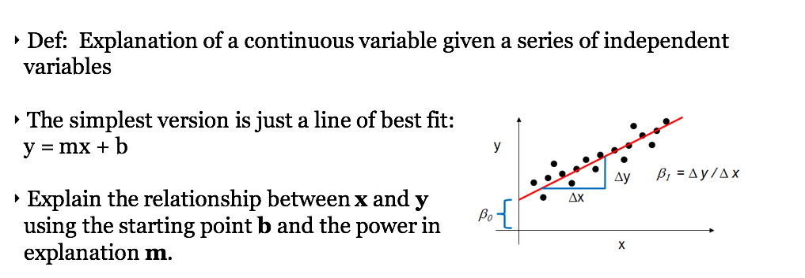
LINEAR REGRESSION

Slide 25
LINEAR REGRESSION
y=Xβ+ϵ
y = target variable
X = input variable
β = coefficients
ϵ = error term
Note, one of our input variables can be 1 so we have an intercept parameter

Slide 26

LINEAR REGRESSION - EXAMPLE
We want to predict the price of a house, based on some observed data we have about the area, number of bedrooms, size of the house, and if it has a pool or not.
The goal is a function y = f(X), to describe the house price based on observed data.
y : house price $
X’s : the area (x1), number of bedrooms (x2), size of the house (x3), and if it has a pool or not (x4)

Slide 27
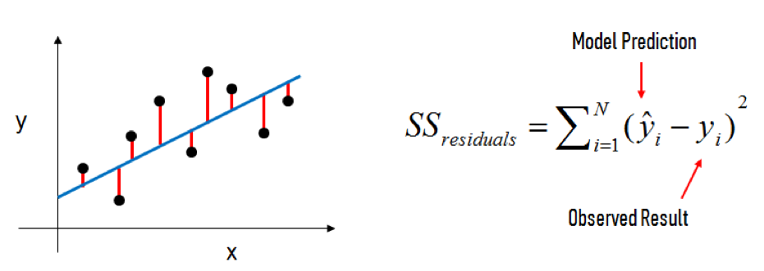
LINEAR REGRESSION

Slide 28
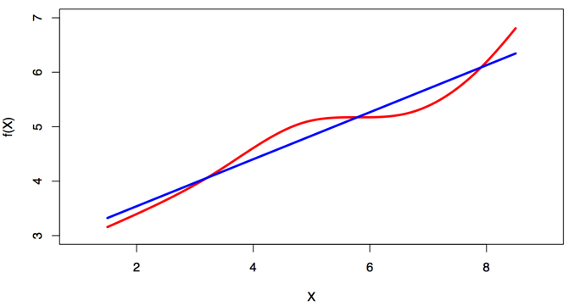
LINEAR REGRESSION
Linear regression is a simple approach to supervised learning. It assumes that the dependence of Y on X1, X2 ,… Xp is linear.
True regression functions are never linear

Slide 29
LINEAR REGRESSION - REQUIREMENTS
Linear relationship in the parameters, β, we can transform the actual values of the inputs if we want
Variance of the error term, ϵ, is constant. This means there is no systematic pattern in the values of X and the variance of ϵ
The mean of ϵ = 0
ϵ has a normal distribution. If it does not, it could introduce bias.
No perfect (or near perfect) co-linearity between any of the input variables. Otherwise the fitting procedure will break.

Slide 30
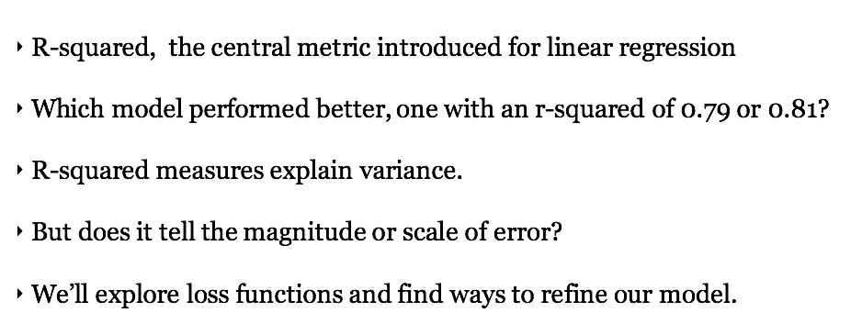
LINEAR REGRESSION - REQUIREMENTS

Slide 31
EVALUATING QUALITY OF FIT?
DATA SCIENCE PART TIME COURSE

Slide 32
LINEAR REGRESSION – MEASURING MODEL RESULTS
Perfect agreement between predicted and actual values: R² = 1 Awful / No agreement between predicted and actual values: R² = close to zero
http://docs.statwing.com/interpreting-residual-plots-to-improve-your-regression/

Slide 33
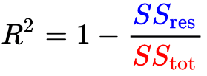
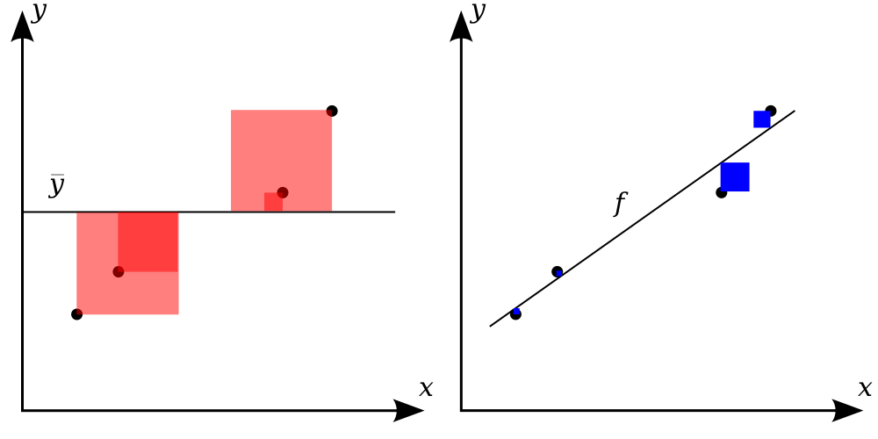
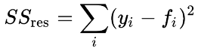
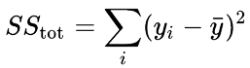
LINEAR REGRESSION – MEASURING MODEL RESULTS
R-Squared

Slide 34
HOW TO RUN LINEAR REGRESSION?
DATA SCIENCE PART TIME COURSE

Slide 35
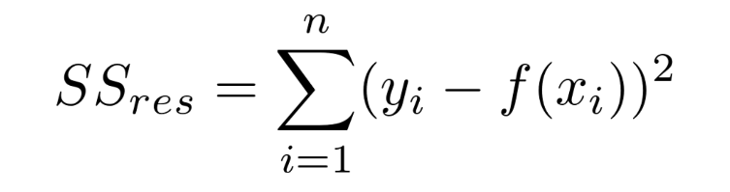
ORDINARY LEAST SQUARES
y=Xβ+ϵ
Basically, what we are trying to do is minimise the Residual Sum of Squares. This is the Sum of the squared difference between our observed value and the value from the model

Slide 36
ORDINARY LEAST SQUARES
y=Xβ+ϵ
Basically, what we are trying to do is minimise the Residual Sum of Squares. This is the Sum of the squared difference between our observed value and the value from the model

Slide 37
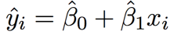
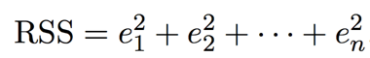
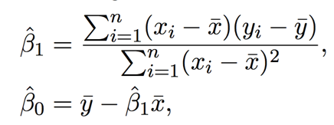
ORDINARY LEAST SQUARES
1
2
3
4

Slide 38
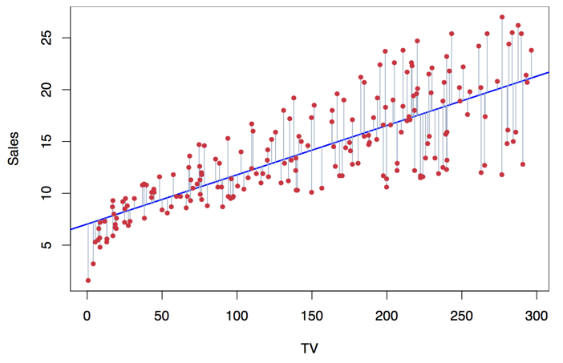
LINEAR REGRESSION

Slide 39
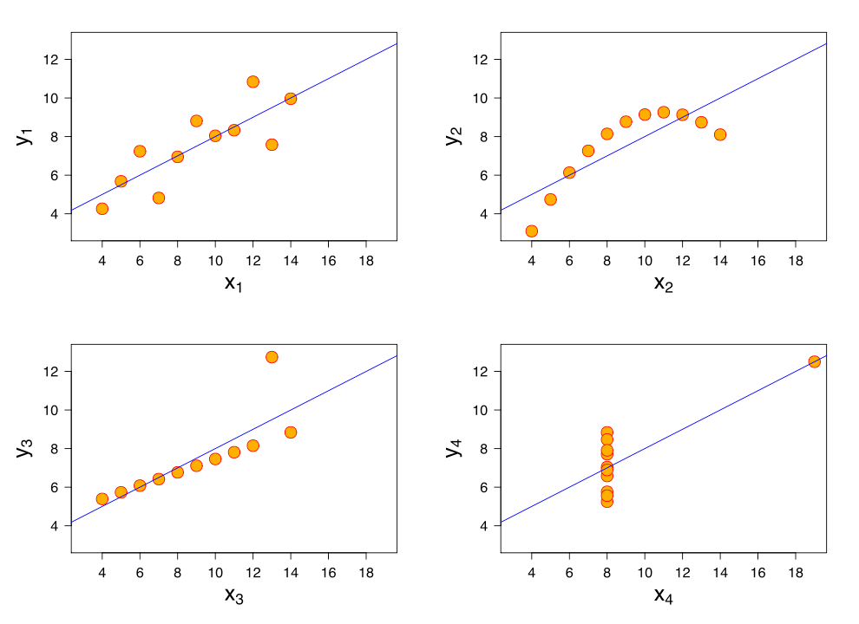
LINEAR REGRESSION - IMPORTANT STEP
Recognise whether the relationship between a data feature and target variable is actually something like linear.
If it is not, you will want to either transform the variable to make it linear, or you may decide to throw the feature away.

Slide 40
MULTIPLE LINEAR REGRESSION
DATA SCIENCE PART TIME COURSE

Slide 41
MULTIPLE LINEAR REGRESSION
multi-dimensions
allows for complex models even with linear components

Slide 42
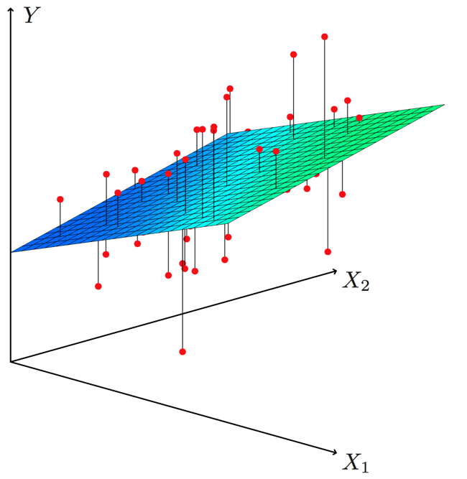
MULTIPLE LINEAR REGRESSION

Slide 43
INTERPRETING COEFFICIENTS
The ideal scenario is when the predictors are uncorrelated:
Interpretations can be made such as “a unit change in Xj is associated with a βj change in Y , while all the other variables stay fixed”
Correlations amongst predictors cause problems
when Xj changes, everything else changes

Slide 44
NON-LINEAR EFFECTS USING LINEAR REGRESSION
DATA SCIENCE PART TIME COURSE

Slide 45
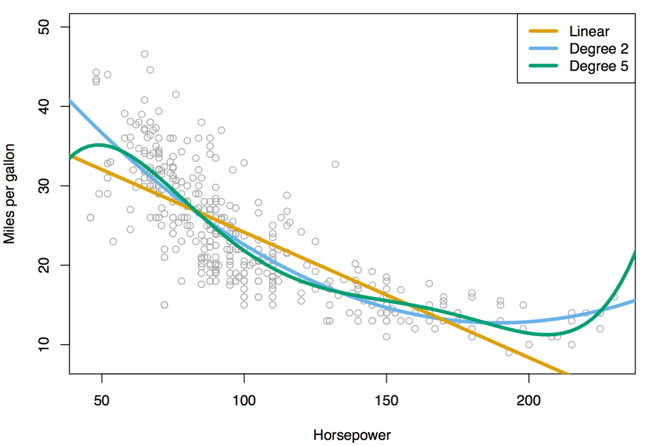
MULTIPLE LINEAR REGRESSION

Slide 46
LAB
DATA SCIENCE PART TIME COURSE

Slide 47
DATA SCIENCE PART TIME COURSE
Refer to the Git 1-pager at:
dat11syd / docs

Slide 48
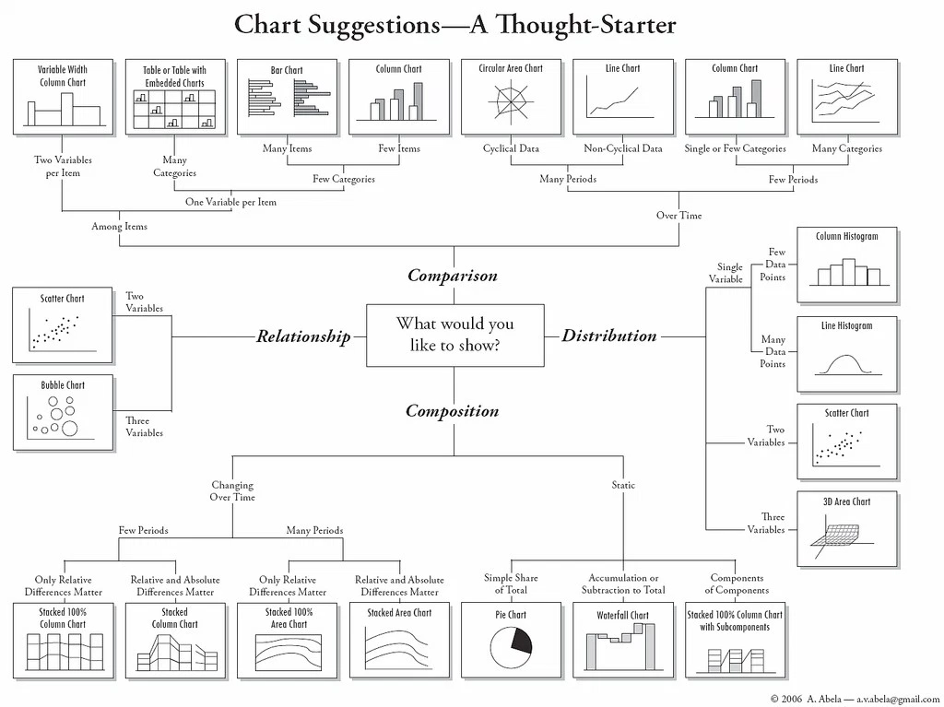

Slide 49
DISCUSSION TIME
Homework (Due Tue 28th Nov)
Apply Linear Regression Example to your own project
Make one plot and
A linear regression
Slack your Jupyter notebook to me or push to your repo and let me know on slack
Read Chapter 4 of Introduction to Statistical Learning - Classification
If your data does not lend itself to regression use this dataset http://archive.ics.uci.edu/ml/datasets/Auto+MPG
To get data click “Data Folder” at top of page
DATA SCIENCE

